Slide 1
CHAPTER 6 INTERCONNECTION NETWORKS
DESIGN SPACE
SWITCHING STRATEGIES
FLOW CONTROL
TOPOLOGIES
ROUTING TECHNIQUES

Slide 2
PARALLEL COMPUTER SYSTEMS
INTERCONNECT BETWEEN PROCESSOR CHIPS (SYSTEM AREA NETWORK--SAN)
INTERCONNECT BETWEEN CORES ON EACH CHIP (ON-CHIP-NETWORK--OCN or NETWORK ON A CHIP--NOC)
OTHERS (NOT COVERED):
WAN (WIDE-AREA NETWORK)
LAN (LOCAL AREA NETWORK)

Slide 3
EXAMPLE: MESH
CONNECTS NODES: CACHE MODULES, MEMORY MODULES, CMPS…
NODES ARE CONNECTED TO SWITCHES THROUGH A NETWORK INTERFACE (NI)
SWITCH: CONNECTS INPUT PORTS TO OUTPUT PORTS
LINK: WIRES TRANSFERING SIGNALS BETWEEN SWITCHES
LINKS
WIDTH, CLOCK
TRANSFER CAN BE SYNCHRONOUS OR ASYNCHRONOUS
FROM A TO B: HOP FROM SWITCH TO SWITCH
DECENTRALIZED (DIRECT)

Slide 4
SIMPLE COMMUNICATION MODEL
POINT-TO-POINT MESSAGE TRANSFER
REQUEST/REPLY: REQUEST CARRIES ID OF SENDER
MULTICAST: ONE TO MANY
BROADCAST: ONE TO ALL

Slide 5
MESSAGES AND PACKETS
MESSAGES CONTAIN THE INFORMATION TRANSFERED
MESSAGES ARE BROKEN DOWN INTO PACKETS
PACKETS ARE SENT ONE BY ONE
PAYLOAD: MESSAGE--NOT RELEVANT TO INTERCONNECTION
HEADER/TRAILER: CONTAINS INFORMATION TO ROUTE PACKET
ERROR CODE: ECC TO DETECT AND CORRECT TRANSMISSION ERRORS
HEADER+ECC+TRAILER = PACKET ENVELOPE

Slide 6
EXAMPLE: BUS
BUS=WIRES
BROADCAST/BROADCALL COMMUNICATION.
NEEDS ARBITRATION.
CENTRALIZED vs DISTRIBUTED ARBITRATION
LINE MULTIPLEXING (ADDRESS/DATA FOR EXAMPLE)
PIPELINING
FOR EXAMPLE: ARBITRATION => ADDRESS => DATA
SPLIT-TRANSACTION BUS vs CIRCUIT-SWITCHED BUS
CENTRALIZED (INDIRECT)
LOW COST
SHARED
LOW BANDWIDTH

Slide 7
SWITCHING STRATEGY
DEFINES HOW CONNECTIONS ARE ESTABLISHED IN THE NETWORK
CIRCUIT SWITCHING
ESTABLISH A CONNECTION FOR THE DURATION OF THE NETWORK SERVICE
EXAMPLE.: REMOTE MEMORY READ ON A BUS:
CONNECT WITH REMOTE NODE
HOLD THE BUS WHILE THE REMOTE MEMORY IS ACCESSED
RELEASE THE BUS WHEN THE DATA HAS BEEN RETURNED
EXAMPLE: CIRCUIT SWITCHING IN MESH
ESTABLISH PATH IN NETWORK
TRANSMIT PACKET
RELEASE PATH
LOW LATENCY; HIGH BANDWIDTH
GOOD WHEN PACKETS ARE TRANSMITTED CONTINUOUSLY BETWEEN TWO NODES
PACKET SWITCHING
MULTIPLEX SEVERAL SERVICES BY SENDING PACKETS WITH ADDRESSES
EXAMPLE: REMOTE MEMORY ACCESS ON A BUS
SEND A REQUEST PACKET TO REMOTE NODE
RELEASE BUS WHILE MEMORY ACCESS TAKES PLACE
REMOTE NODE SENDS REPLY PACKET TO REQUESTER
IN BETWEEN SEND AND REPLY, OTHER TRANSFERS ARE SUPPORTED
EXAMPLE: REMOTE MEMORY ACCESS ON A MESH

Slide 8
SWITCHING STRATEGY
PACKET SWITCHING STRATEGIES
TWO STRATEGIES: STORE-AND-FORWARD AND CUT-THROUGH PACKET SWITCHING
IN STORE-AND-FORWARD PACKET SWITCHING, PACKETS MOVE FROM NODE TO NODE AND ARE STORED IN BUFFERS IN EACH NODE
IN CUT-THROUGH PACKET SWITCHING, PACKETS CAN MOVE THROUGH NODES IN PIPELINE FASHION, SO THAT THE ENTIRE PACKET MOVES THROUGH SEVERAL NODES AT ONE TIME
TWO IMPLEMENTATIONS OF CUT-THROUGH PACKET SWITCHING
IN PRACTICE WE MUST DEAL WITH CONFLICTS AND STALL PACKETS
VIRTUAL CUT-THROUGH SWITCHING:
EACH NODE HAS ENOUGH BUFFERING FOR THE ENTIRE PACKET
THE ENTIRE PACKET IS BUFFERED IN THE NODE WHEN THERE IS A TRANSMISSION CONFLICT
WHEN TRAFFIC IS CONGESTED AND CONFLICTS ARE HIGH, VIRTUAL CUT THROUGH BEHAVES LIKE STORE-AND-FORWARD
WORMHOLE SWITCHING:
EACH NODE HAS ENOUGH BUFFERING FOR A FLIT (FLOW CONTROL UNIT)
A FLIT IS MADE OF CONSECUTIVE PHITs (PHYSICAL TRANSFER UNIT), WHICH BASICALLY IS THE WIDTH OF A LINK (NUMBER OF BITS TRANSFERRED PER CLOCK)
THE FLIT IS THE BASIC UNIT OF TRANSFER SUBJECT TO FLOW CONTROL AND IT MUST AT LEAST CONTAIN THE ROUTING INFORMATION AT THE HEAD OF THE PACKET
IN VIRTUAL CUT-THROUGH THE FLIT IS THE WHOLE PACKET
IN WORMHOLE SWITCHING, IS A FRACTION OF THE PACKET, SO THE PACKET MUST BE STORED IN SEVERAL NODES (ONE FLIT PER NODE) ON ITS PATH AS IT MOVES THROUGH THE NETWORK.

Slide 9
SWITCH MICROARCHITECTURE
From Duato and Pinkston in Hennessy and Patterson, 4th edition
PHYSICAL CHANNEL = LINK
VIRTUAL CHANNEL = BUFFERS + LINK
LINK IS TIME-MULTIPLEXED AMONG FLITS

Slide 10
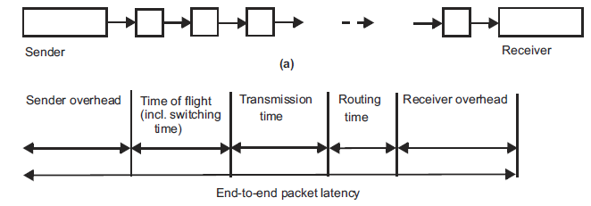
LATENCY MODELS
End-to-end packet latency = Sender OV + Time of flight + Transmission time + Routing time + Receiver OV
SENDER OVERHEAD: CREATING THE ENVELOPE AND MOVING PACKET TO NI
TIME OF FLIGHT: TIME TO SEND A BIT FROM SOURCE TO DESTINATION WHEN THE ROUTE IS ESTABLISHED AND WITHOUT CONFLICTS. (INCLUDES SWITCHING TIME.)
TRANSMISSION TIME: TIME TO TRANSFER A PACKET FROM SOURCE TO DESTINATION, ONCE THE FIRST BIT HAS ARRIVED AT DESTINATION
PHIT: NUMBER OF BITS TRANSFERED ON A LINK PER CYCLE
BASICALLY: PACKET SIZE/PHIT SIZE
FLIT: FLOW CONTROL UNIT

Slide 11
LATENCY MODELS
ROUTING TIME: TIME TO SET UP SWITCHES
SWITCHING TIME: DEPENDS ON SWITCHING STRATEGY (STORE-AND-FORWARD vs CUT-THROUGH vs CIRCUIT-SWITCHED). AFFECTS TIME OF FLIGHT AND INCLUDED IN THAT.
RECEIVER OVERHEAD: TIME TO STRIP OUT ENVELOPE AND MOVE PACKET IN
MEASURES OF LATENCY:
ROUTING DISTANCE: NB OF LINKS TRAVERSED BY A PACKET
AVERAGE ROUTING DISTANCE: AVERAGE OVER ALL PAIRS OF NODES
NETWORK DIAMETER: LONGEST ROUTING DISTANCE OVER ALL PAIRS OF NODES
PACKETS OF A MESSAGE CAN BE PIPELINED
TRANSFER PIPELINE HAS 3 STAGES
SENDER OVERHEAD-->TRANSMISSION -->RECEIVER OVERHEAD
TOTAL MESSAGE TIME = TIME FOR THE FIRST PACKET + (N-1)/PIPELINE THROUGHPUT
End-to-end message latency = Sender OV + Time of Flight + Transmission time + Routing time + (N-1) x MAX (Sender OV, Transmission time, Receiver OV)

Slide 12
SWITCHING STRATEGIES
CIRCUIT SWITCHING:
ROUTE IS SET UP FIRST
Routing time = L x R + Time of flight
R to set each switch, L number of switches, and ToF to inform the node back
PACKET SWITCHING
ROUTE IS SET UP AS THE PACKET MOVES FROM SWITCH TO SWITCH
STORE-AND-FORWARD, CUT-THROUGH

Slide 13
SWITCHING STRATEGIES
Packet latency = Sender ov + ToF (incl.Switching time) + Transmission time + Routing time + Receiver ov
R: routing time per switch; N: Nb of phits; L: Nb of switches; ToF: Time of flight
CIRCUIT SWITCHING
PACKET LATENCY = SENDER OV + 2xToF + N + LxR + RECEIVER OV
ToF = L BECAUSE THERE ARE L SWITCHES AND NB OF PHITS TO SWITCH IS ONE
STORE-AND-FORWARD
PACKET LATENCY = SENDER OV + ToF + N + LxR + RECEIVER OV
ToF = LxN BECAUSE SWITCHING INVOLVES A WHOLE PACKET (N PHITS)
CUT-THROUGH SWITCHING
PACKET LATENCY = SENDER OV + ToF + N + LxR + RECEIVER OV
ToF = L AS IN CIRCUIT SWITCHING
VIRTUAL CUT-THROUGH SWITCHING
SIMILAR TO CIRCUIT SWITCHING BUT BETTER BW
NOTE THAT WHEN TRAFFIC IS CONGESTED, CUT-THROUGH = STORE-AND-FORWARD
WORMHOLE SWITCHING
HANDLES CONFLICTS DIFFERENTLY
SWITCH PORT HAS AT LEAST ENOUGH BUFFERING FOR A FLIT
BLOCKED PACKETS SIMPLY STAY IN THE FLIT BUFFERS PROVIDED IN THEIR PATH
PACKET FLITS HOLD CIRCUITS IN MULTIPLE SWITCHES

Slide 14
BANDWIDTH MODELS
BOTTLENECKS INCREASE LATENCY
TRANSFERS ARE PIPELINED
EFFECTIVE BANDWIDTH = PACKET_SIZE/MAX(SENDER OV, RECEIVER OV, TRANSMISSION TIME)
NETWORK CONTENTION AFFECTS LATENCY AND EFFECTIVE BANDWIDTH (NOT COUNTED IN ABOVE FORMULA)
BISECTION WIDTH
NETWORK IS SEEN AS A GRAPH
VERTICES ARE SWITCHES AND EDGES ARE LINKS
BISECTION IS A CUT THROUGH A MINIMUM SET OF EDGES SUCH THAT THE CUT DIVIDES THE NETWORK GRAPH INTO TWO ISOMORPHIC --I.E., SAME-- SUBGRAPHS
EXAMPLE: MESH
MEASURES BANDWIDTH WHEN ALL NODES IN ONE SUBGRAPH COMMUNICATE ONLY WITH NODES IN THE OTHER SUBGRAPH
AGGREGATE BANDWIDTH
BANDWIDTH ACROSS ALL LINKS DIVIDED BY THE NUMBER OF NODES

Slide 15
TOPOLOGIES
INDIRECT NETWORKS: IN IS CENTRALIZED
BUS
CROSSBAR SWITCH
MULTISTAGE INTERCONNECTION NETWORK (MIN)

Slide 16
TOPOLOGIES
INDIRECT NETWORKS: IN IS CENTRALIZED
TREE
BUTTERFLY
BEST TO CONNECT DIFFERENT TYPES OF NODES

Slide 17
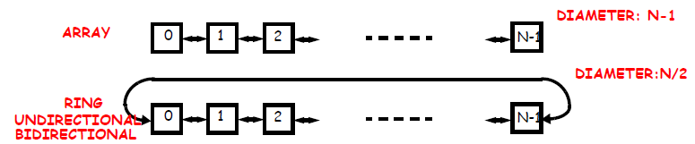
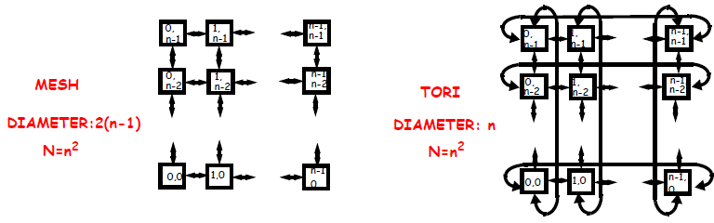
TOPOLOGIES
DIRECT NETWORKS: NODES ARE DIRECTLY CONNECTED TO ONE ANOTHER
DECENTRALIZED
LINEAR ARRAY AND RING
MESH AND TORI

Slide 18
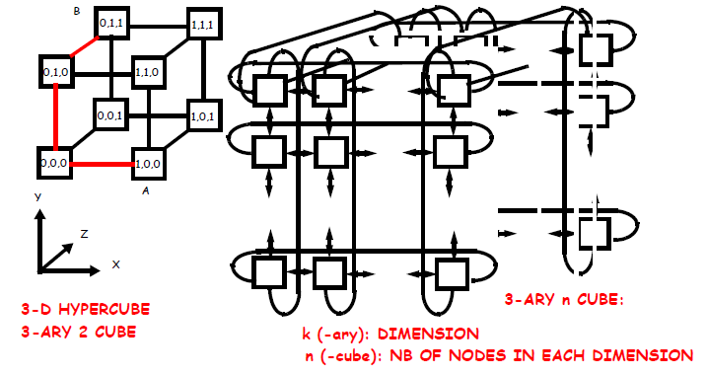
TOPOLOGIES
DIRECT NETWORKS: NODES ARE DIRECTLY CONNECTED TO ONE ANOTHER
HYPERCUBE AND k-ARY n-CUBE

Slide 19
COMPARISON BETWEEN TOPOLOGIES
Interconnection network | Switch degree | Network diameter | Bisection width | Network size
Crossbar switch | N | 1 | N | N
Butterfly (built from k-by-k switches) | k | log_{k} N | N/2 | N
k-ary tree | k+1 | 2log_{k} N | 1 | N
Linear array | 2 | N-1 | 1 | N
Ring | 2 | N/2 | 2 | N
n-by-n mesh | 4 | 2(n-1) | n | N=n²
n-by-n torus | 4 | n | 2n | N=n²
k-dimensional hypercube | k | k | 2^{k-1} | N=2^{k}
k-ary n-cube | 2k | nk/2 | 2k^{n-1} | N=n^{k}
SWITCH DEGREE: NUMBER OF PORTS FOR EACH SWITCH (SWITCH COMPLEXITY)
NETWORK DIAMETER: WORST-CASE ROUTING DISTANCE BETWEEN ANY TWO NODES
BISECTION WIDTH: NB OF LINKS IN BISECTION (WORST-CASE BW)
NETWORK SIZE: NB OF NODES

Slide 20
FLOW CONTROL
REFERS TO MECHANISMS TO HANDLE CONFLICTS IN SWITCH-BASED NETWORKS
BUFFERS AT INPUT AND OUTPUT PORTS
IN VIRTUAL CUT-THROUGH: BUFFER FOR ENTIRE PACKET
IN WORMHOLE: BUFFER FOR INTEGRAL NUMBER OF FLITS
LINK-LEVEL FLOW CONTROL
HANDSHAKE SIGNAL
Rdy INDICATES WHETHER FLITS CAN BE TRANSMITTED TO THE DESTINATION
BUFFERING FOR CUT-THROUGH (whole packet) vs WORMHOLE (a few flits)
HOT SPOT CONTENTION AND TREE SATURATION

Slide 21
ROUTING ALGORITHMS
USE SOURCE AND/OR DESTINATION ADDRESSES
OMEGA NETWORK

Slide 22
ROUTING ALGORITHMS
BUTTERFLY NETWORK

Slide 23
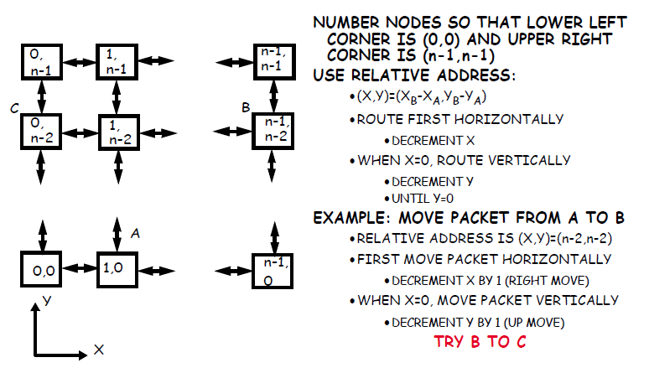
ROUTING ALGORITHMS
DIMENSION-ORDER ROUTING (DETERMINISTIC)

Slide 24
DEADLOCK AVOIDANCE
IN GENERAL THERE ARE FOUR NECESSARY CONDITIONS FOR DEADLOCK, GIVEN A SET OF AGENTS ACCESSING A SET OF SHARED RESOURCES:
MUTUAL EXCLUSION
ONLY ONE AGENT CAN ACCESS THE RESOURCE AT A TIME
NO PREEMPTION
ONCE AN AGENT HAS ACQUIRED A SHARED RESOURCE, NO MECHANISM CAN FORCE IT TO RELINQUISH THE RESOURCE
HOLD AND WAIT
AGENT HOLDS ON ITS ACQUIRED RESOURCES WHILE WAITING FOR OTHERS
CIRCULAR WAIT
A SET OF AGENTS WAIT ON EACH OTHER TO ACQUIRE EACH OTHERS’ RESOURCES SO THAT NO ONE CAN MAKE ANY PROGRESS
IN GENERAL, THE SHARED RESOURCES CAN BE SOFTWARE OR HARDWARE
CRITICAL SECTIONS, DISK, PRINTER, ETC...
IN THE CASE OF NETWORKS
AGENTS = PACKETS; RESOURCES = PHYSICAL OR LOGICAL CHANNELS

Slide 25
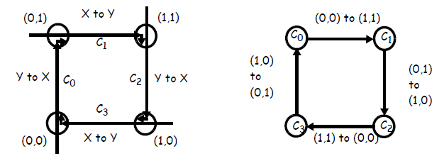
DEADLOCK AVOIDANCE
ASSUME MESH OR TORI
ASSUME THAT PACKETS ARE FREE TO FOLLOW ANY ROUTE
IN THIS EXAMPLE EACH NODE IS TRYING TO SEND A PACKET TO THE DIAGONALLY OPPOSITE NODE AT THE SAME TIME
E.G., (0,0) TO (1,1)
TO AVOID LINK CONFLICTS, (1,0) USES C₃ THEN C₀ AND (0,0) USES C₀ THEN C₁, ETC...
THE RESOURCE ACQUISITION GRAPH (or CHANNEL-DEPENDENCY GRAPH) ON THE RIGHT SHOWS CIRCULAR WAIT
MEANS: DEADLOCK IS POSSIBLE

Slide 26
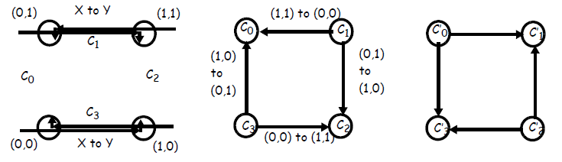
DEADLOCK AVOIDANCE
ENFORCE DIMENSION-ORDER ROUTING (XY ROUTING)
PACKET MOVES FIRST HORIZONTALLY
THEN VERTICALLY
NO CYCLE!!!
PROBLEM: CONTENTION FOR CHANNELS
IF (0,0) WANTS TO SEND A PACKET TO (1,1), IT MUST FIRST USE C₃
IF C₃ IS OCCUPIED, COULD TAKE ALTERNATE ROUTE C₀ => C₁
TO AVOID DEADLOCKS, USE VIRTUAL CHANNELS
ALTERNATE SET OF CHANNELS IN WHICH YX ROUTING IS ENFORCED E.G., C’₁
IF C₃ IS OCCUPIED, THE PACKET CAN SAFELY ROUTE THROUGH C’₀ AND C’₁.

